Slide 1
Supplement to Lecture XI: Structure Formation (Numerical Results)

Slide 2
Scales of interest
a
1
matter-Λ
equality
Nonlinear transition, Δ~1
0.1
IGM reheating
10⁻²
Baryons smoothly distributed
Baryon and DM perturbations grow ~ G(a)
10⁻³
recombination
DM switches to growth δ~a
matter-radiation
equality
10⁻⁴
Silk damping
10⁻⁵
DM perturbations grow logarithmically
Acoustic oscillations in baryon-photon plasma
light-crossing time
No causal communication possible
Relativistic analysis necessary
10⁻⁶
sound-crossing time
10⁻⁷
[comoving scale]
π/k
1 kpc
10 kpc
100 kpc
1 Mpc
10 Mpc
100 Mpc
1 Gpc
10 Gpc

Slide 3
Transfer function: results
Eisenstein & Hu (1998) formulae
T(k)
k (Mpc⁻¹)

Slide 4
Major Techniques
Higher-order perturbation theory
Useful for weakly nonlinear evolution, e.g. large scale structure at ~ 10 Mpc scales
But will never understand galaxy formation by doing this!
N-body simulations
“Exact” solution of DM-only evolution even when δ>>1
Understand formation/structure of galaxy haloes, merger history, …
Analytic treatments of halo formation
Useful for gaining intuition
But not as accurate as full N-body approaches

Slide 5
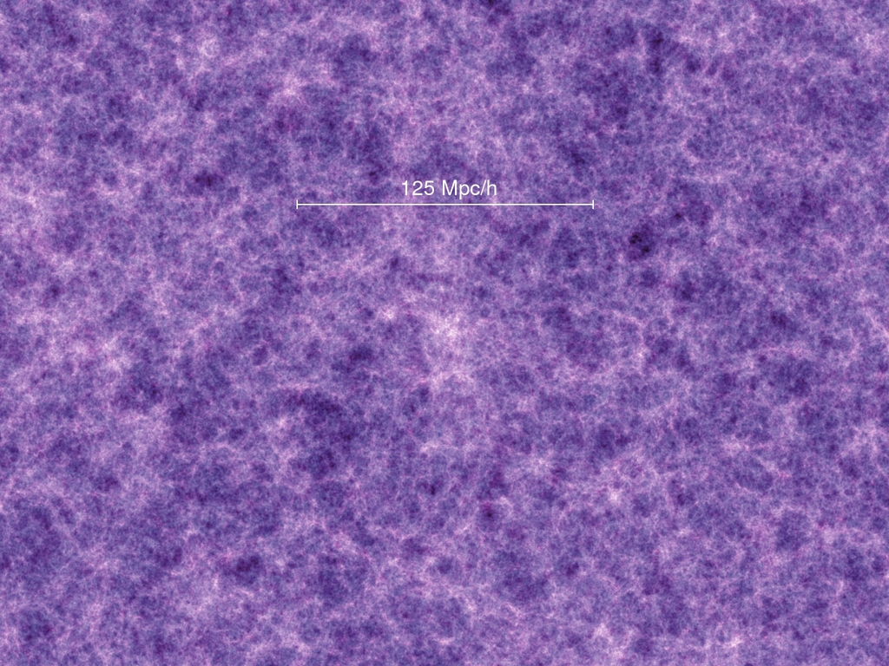
Simulated Dark Matter Distribution (15 Mpc/h thick slice)
Millenium Simulation, Springel et al 2005
z=18.3

Slide 6
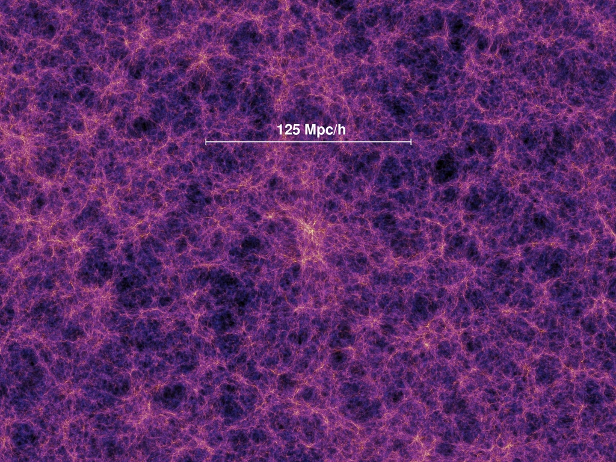
Simulated Dark Matter Distribution (15 Mpc/h thick slice)
Millenium Simulation, Springel et al 2005
z=5.7

Slide 7
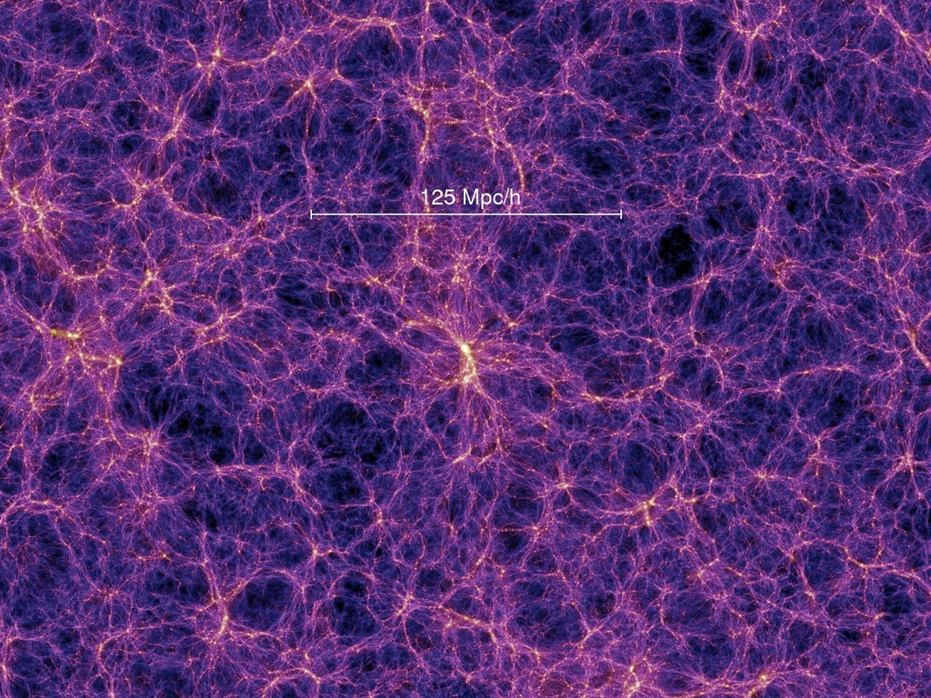
Simulated Dark Matter Distribution (15 Mpc/h thick slice)
Millenium Simulation, Springel et al 2005
z=1.4

Slide 8
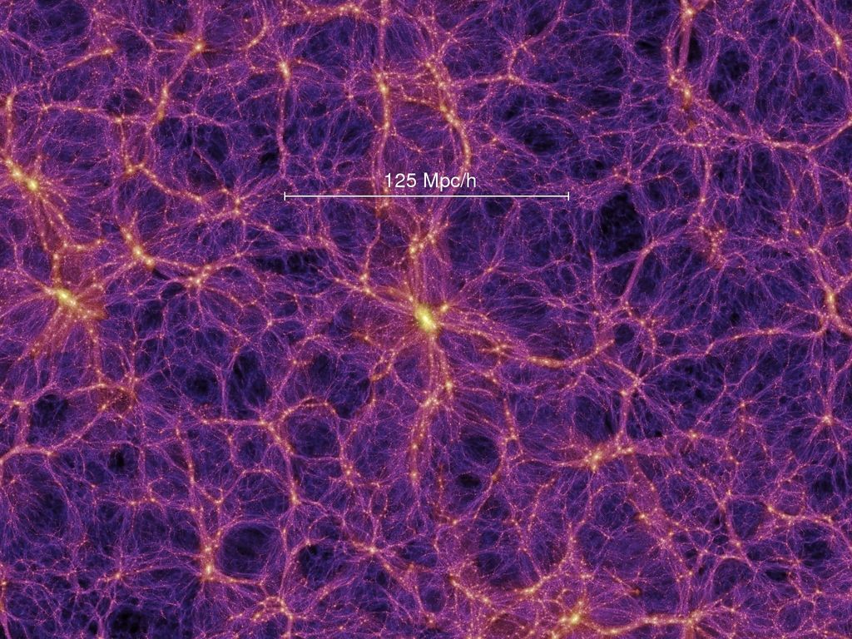
Simulated Dark Matter Distribution (15 Mpc/h thick slice)
Millenium Simulation, Springel et al 2005
z=0.0

Slide 9
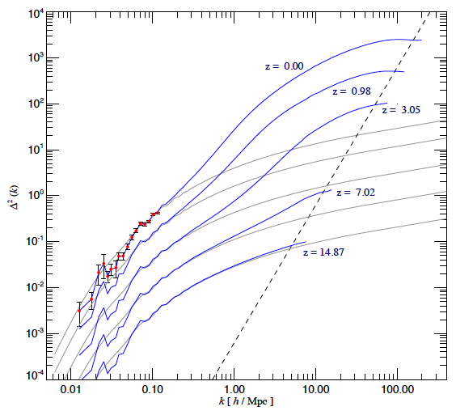
Nonlinear Power Spectrum
Millenium Simulation
Springel et al 2005
Gray = linear theory

